Slide 1
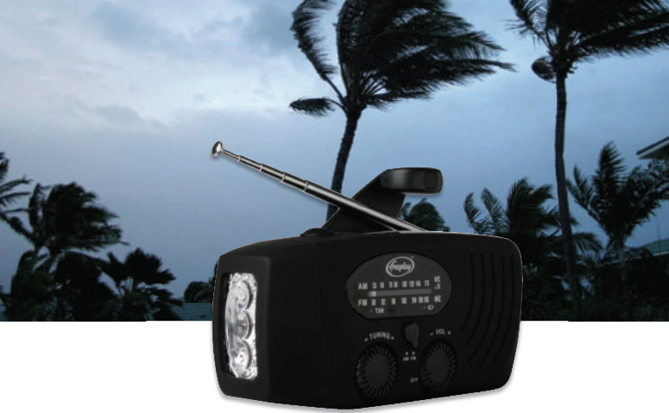
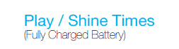
COMPANIONTM Radio Flashlight
Radio 12 hr
Light 7 hr
Features
All-in-one radio, flashlight and phone charger with power crank!
Portable AM/FM Radio with headphone jack.
Bright, high-quality LED Flashlight.
Emergency phone charger through cranking.
4 Charging options for light & radio: power crank, solar, USB and AC.
Benefits
Constant companion that never lets you down.
Save money – reduce spending on batteries.
Always connected during emergencies – get the latest news and top-up your phone.
Never run out of power – just wind it up.
Enjoy your favorite songs and radio-dramas.
Evening chores and trips are safer and easier – light at the push of a button.
Use it anytime, anywhere – rugged, handy and portable.
Power Crank
Just wind to charge.
Price
Version: 130919

Slide 2
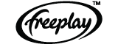
FACT SHEET: COMPANIONTM Radio Flashlight
About the Companies
High-quality and durable.
NAME
CompanionTM Radio Flashlight
PRODUCT DESCRIPTION
The Companion Radio Flashlight is a dependable all-in-one radio, flashlight and emergency phone charger with power crank.
CHARGE INFORMATION
Fully recharged battery
12 hours radio (normal volume)
7 hours light
Power Crank (60-seconds)
Radio
60 minutes (low volume)
20 minutes (normal volume)
Light
30 minutes shine
Phone
2-3 minutes talk time
USB/AC Adapter
10 hours – 100% Capacity
Solar Panel
20 hours solar exposure – 100% Capacity
Note: Radio play time will vary between volume settings. Phone usage times will vary between phone models, battery condition, and signal strength
LIGHT
The Companion has three bright LEDs built into a flashlight of 25 Lumens. When switched on these LEDs provide a useful beam of light.
MOBILE PHONE CHARGING
The Companion has a power-out socket that delivers power from the alternator to a mobile phone. Connectivity is via a cable with adaptor tips customized for each particular mobile phone. Adaptor tips not included.
MATERIALS
Power Crank
A glass-reinforced nylon handle with comfortable knob harnesses human energy by cranking. The handle is connected to the 3-phase alternator with nylon gears.
Solar Panel
A polycrystalline 3.6V 20mA solar panel with epoxy encapsulation under a polycarbonate lens is integrated into the radio. This serves to play the radio or to charge its batteries without having to wind.
Battery
A rechargeable 350mA NiMH 3 cell battery pack stores the energy generated from human and solar power.
Antenna
FM: Telescopic antenna
AM (MW): internal ferrite rod antenna.
Outer Casing
UV-resistant plastic.
SPEAKER
4cm 1 W, 8-ohm loudspeaker.
FREQUENCIES
FM: 88- 108 Mhz
AM (MW): 520- 1700 kHz
DIMENSIONS
Height: 63mm
Width: 130mm
Depth: 45mm
Weight: 220g
IN-HOUSE QUALITY CONTROL
ISO9001 certified
WARRANTY
1 Year
Freeplay Energy is the leading manufacturer of windup and solar powered products, focused in Emergency Preparedness, Aid and Development, and Outdoor Leisure. Freeplay has been the original and leading global brand of clean, dependable energy products since 1994. Based in the UK, Freeplay received the INDEX:Award in 2009.
Distributed by
Hybrid Social Solutions, Inc. (HSSi) is a socially-oriented company that aims to alleviate poverty by providing rural Philippine communities access to basic goods and services. HSSi is founded and headed by Jim Ayala, the Ernst & Young Social Entrepreneur of the Year 2012.
For more information, please contact:
Manila Office: (02) 843-5609 / (0926) 696-3492 (0929) or email: contact@hybridsolutions.asia

